Slide 1

CONTENTS
Features (2 min)
Live Demo (2 min)
Application Logic (3 min)
Algorithm
Code
Development/Build Process (3 min)
Challenges
Ethical issues
Favourite parts

Slide 2

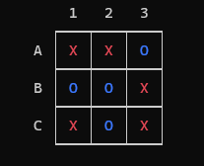
Unbeatable TicTacToe AI
Punit Dharmadhikari T1A3 Terminal Application

Slide 3

Features
Single and Multiplayer Mode
Simulation Mode
Helpful Instructions
Saving Games to File
Loading Previous Games from File
Unbeatable TicTacToe AI

Slide 4
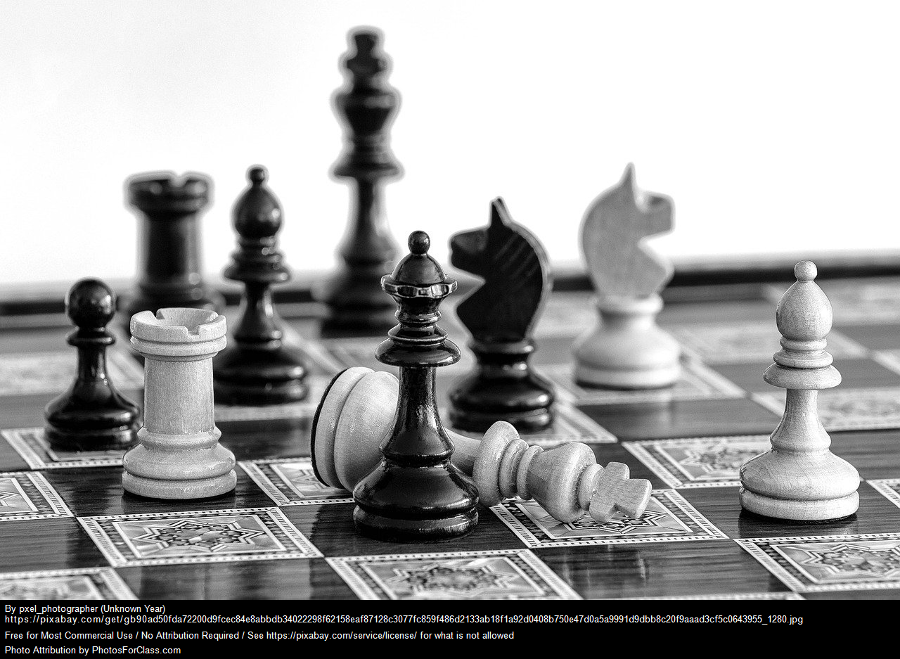
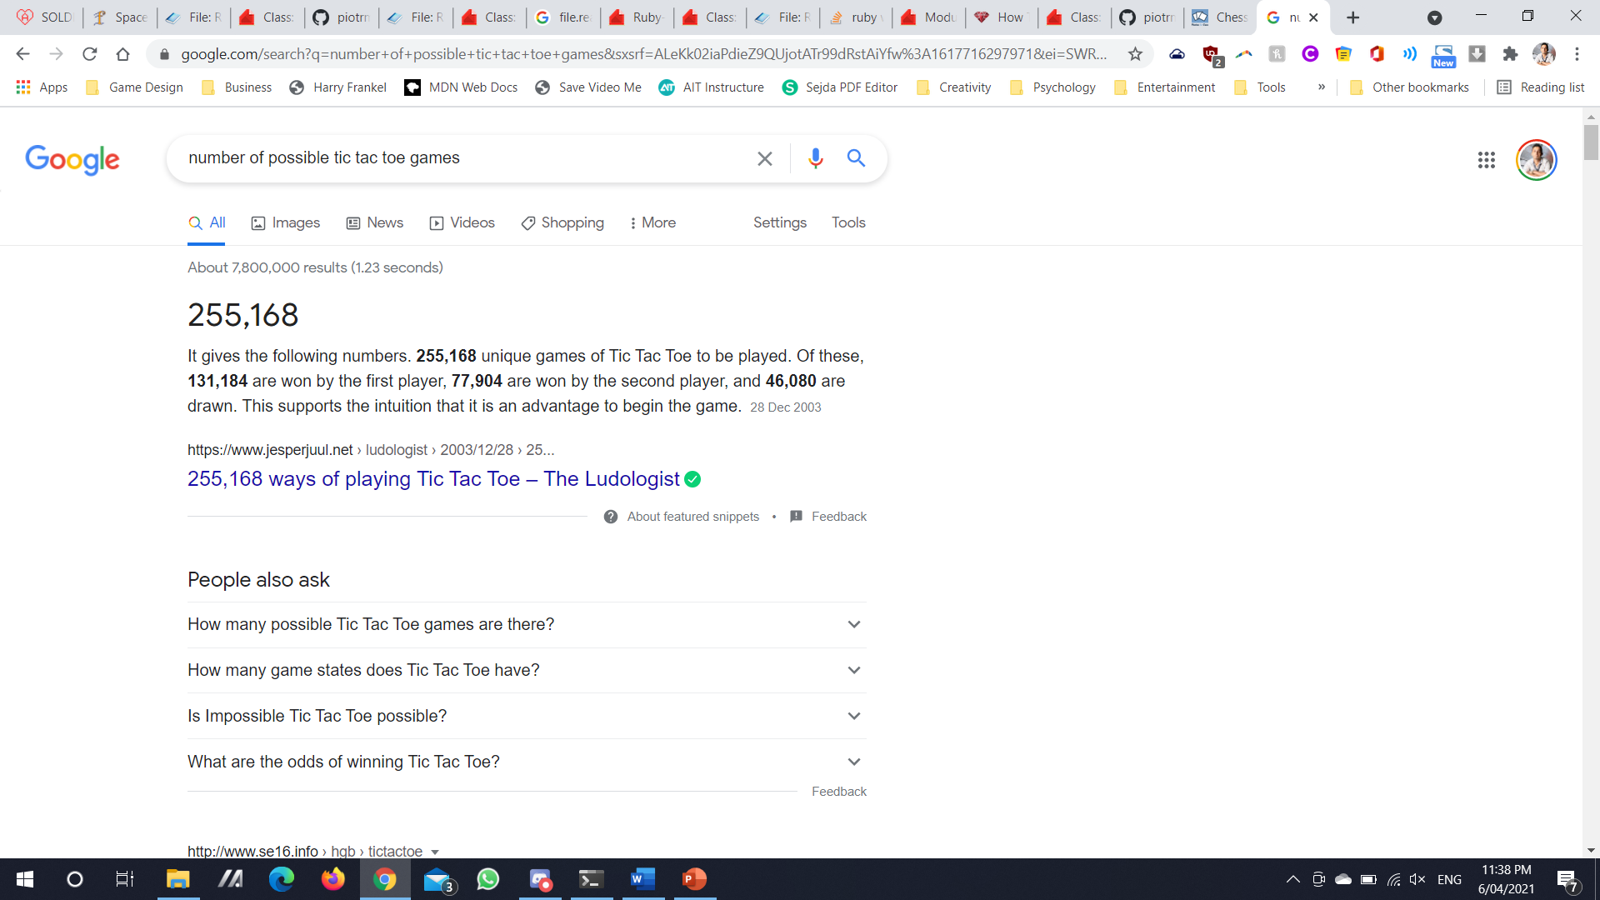
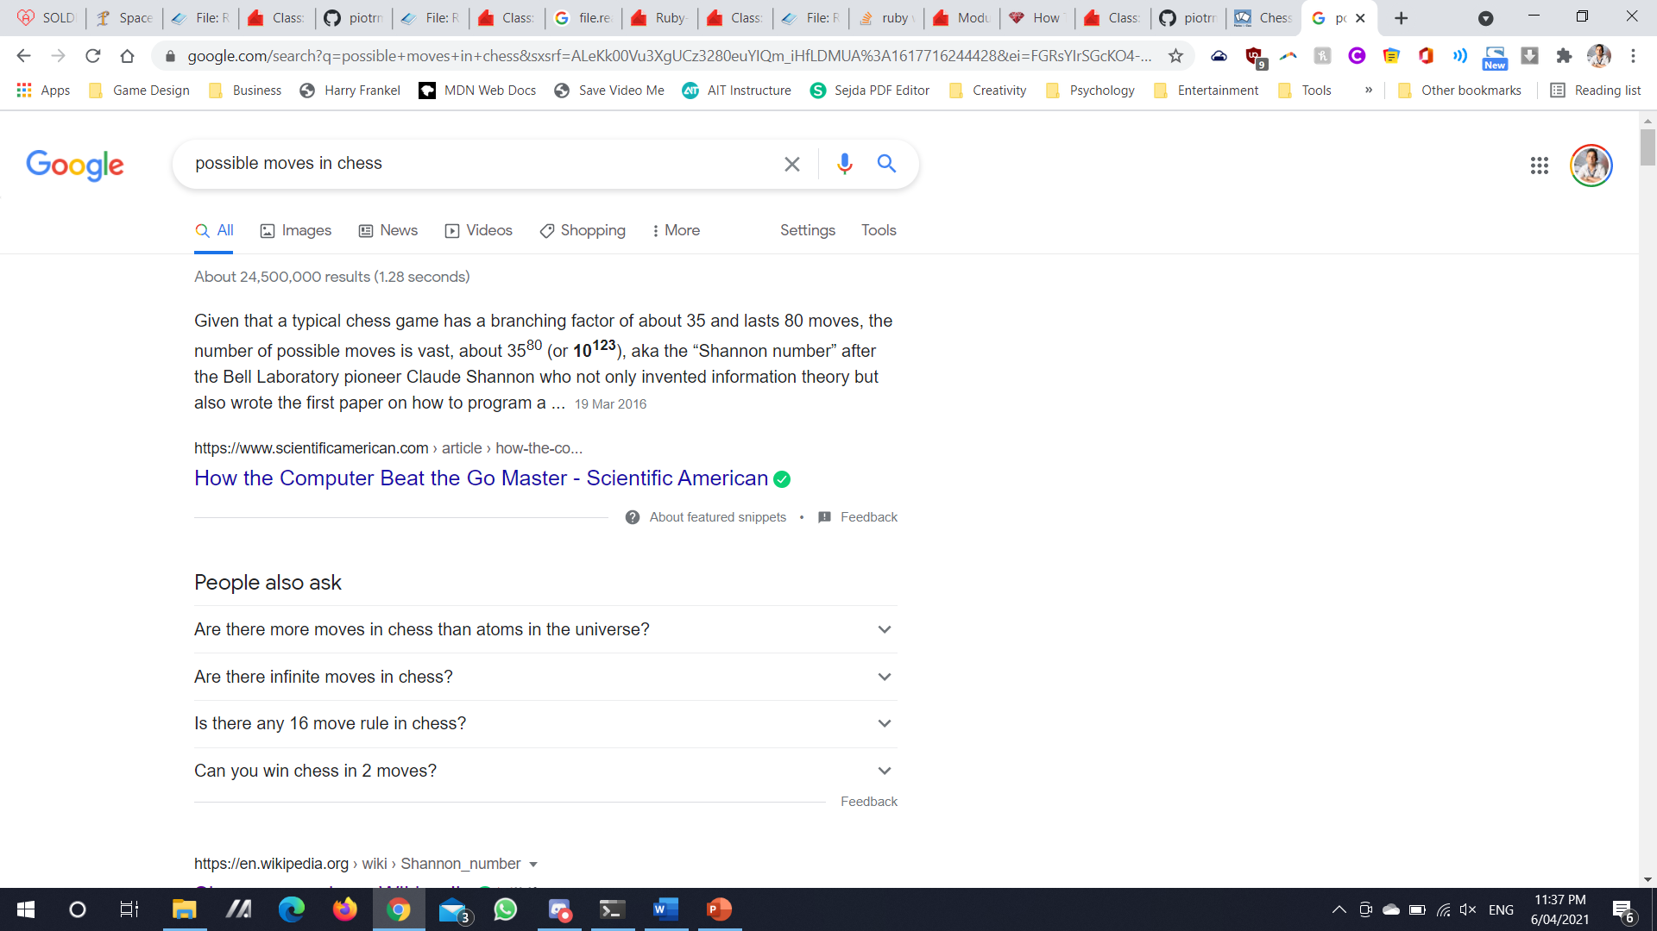
Game Tree Complexity

Slide 5
Live Demo

Slide 6
Code
<CODE> </CODE>
Coding process

Slide 7

Ruby Gems
TTY-PROMPT
To create selectable option menus
COLORIZE
To add colour and life to the project
TTY-TABLE
To create neat-looking tables that display game information
UUID
To create unique IDs for games

Slide 8
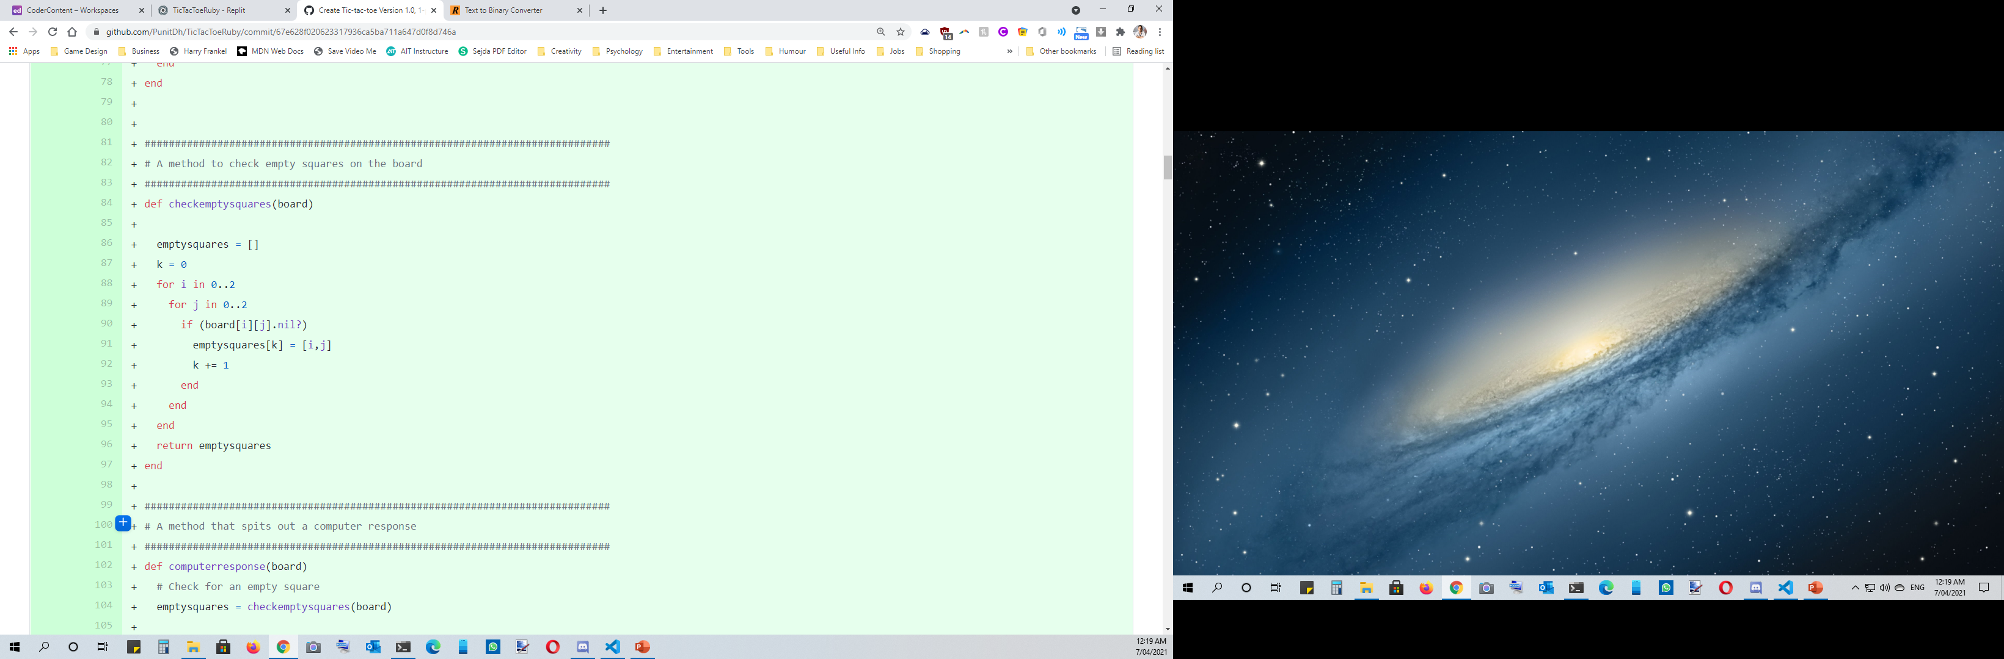
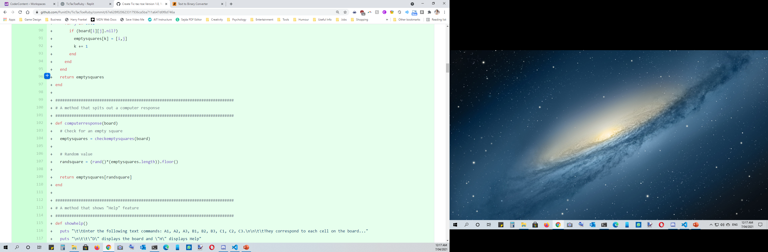
Computer move…

Slide 9
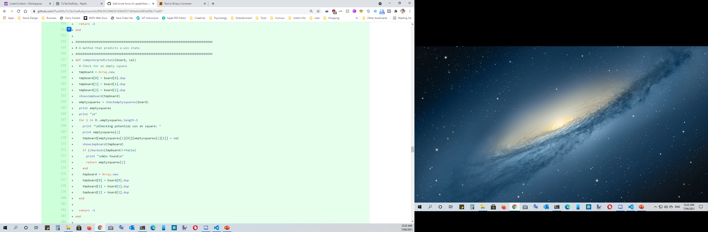
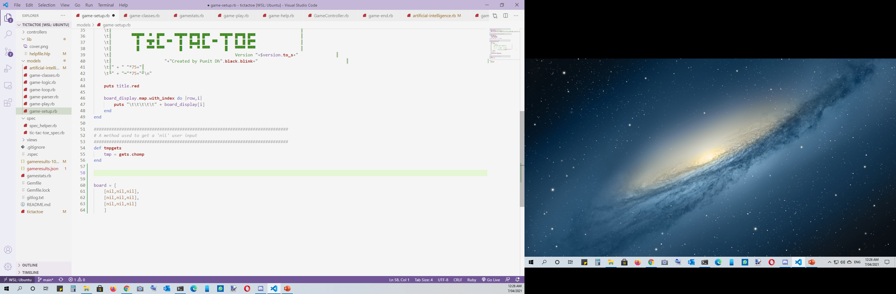









Computer move…
Notes:
It’s still not good enough… I want the computer to be able to beat the player

Slide 10
Algorithm
010000010110110001100111011011110111001001101001011101000110100001101101…
Behaviour Trees

Slide 11
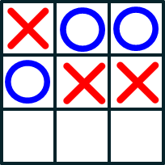

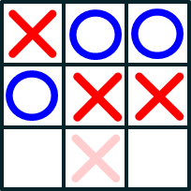
Minimax Algorithm
X’s turn to play

Slide 12
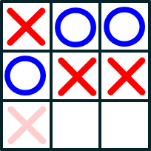
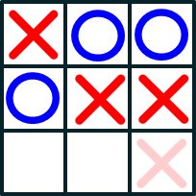
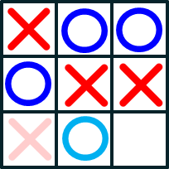
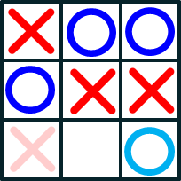
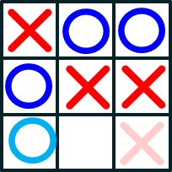
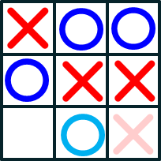
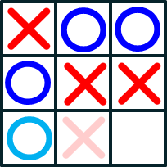
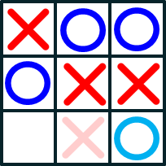
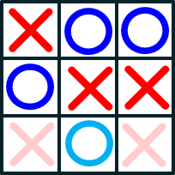
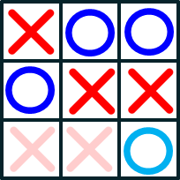
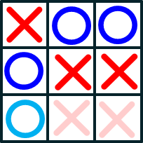
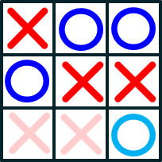
Minimax Algorithm
Score: 1
Score: 1
Score: 1
Is it a win?
Is it a draw?
X’s turn to play
Is it a win?
Is it a draw?
O’s turn to play
Is it a win?
Is it a draw?
X’s turn to play
Score: 1
Score: 0
Score: 1
Score: 0

Slide 13
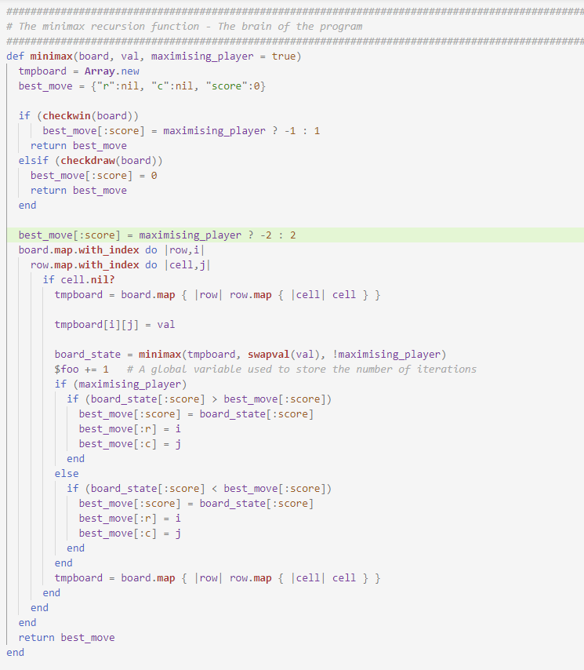
Minimax Algorithm
Notes:
So what does this look like in code?

Slide 14
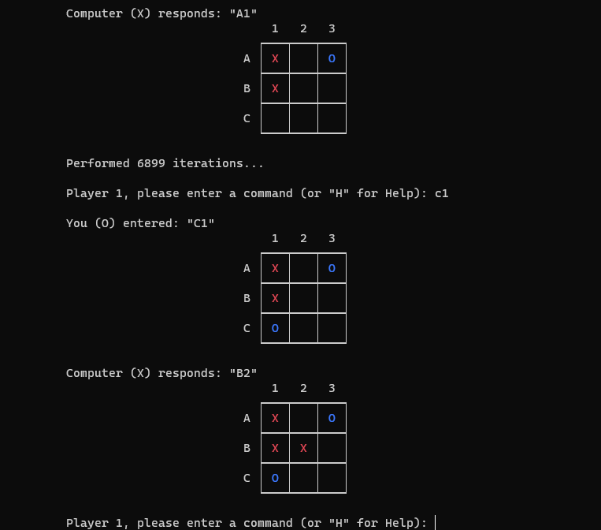
WHAT DO WE DO?
Notes:
Here is one of my most famous losses

Slide 15
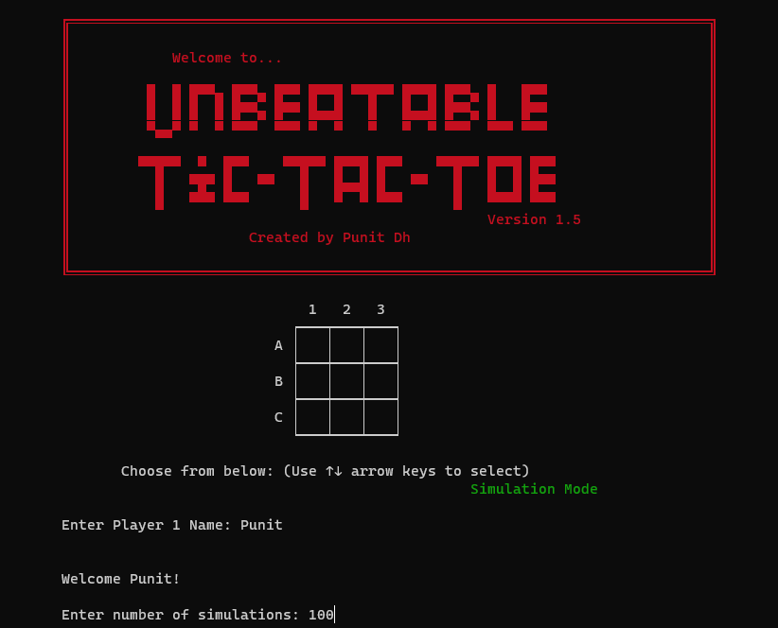
Simulation Mode

Slide 16
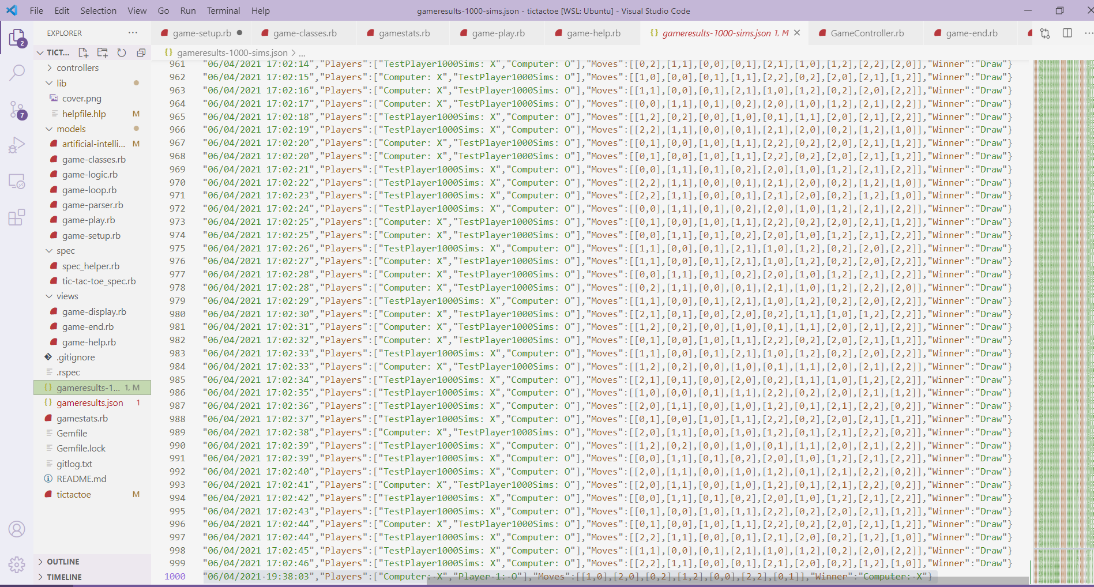
Results

Slide 17

Development and Build Process

Slide 18
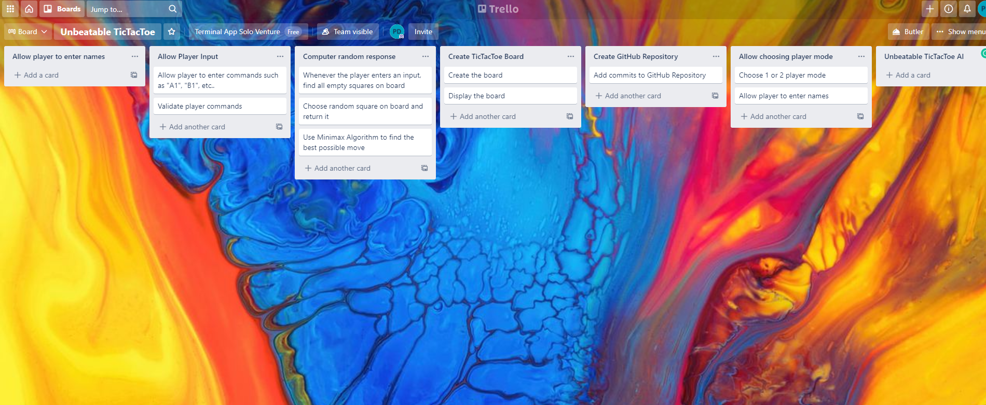
Project Management Platform
https://trello.com/b/HZZdvodu/unbeatable-tictactoe

Slide 19
Classes

Slide 20
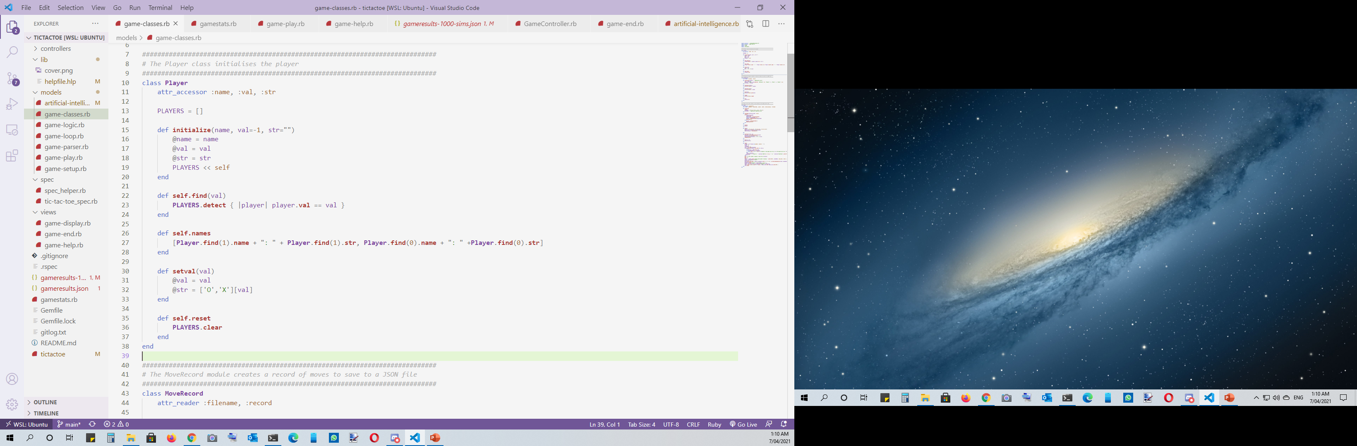




Slide 21
Control Flow

Slide 22


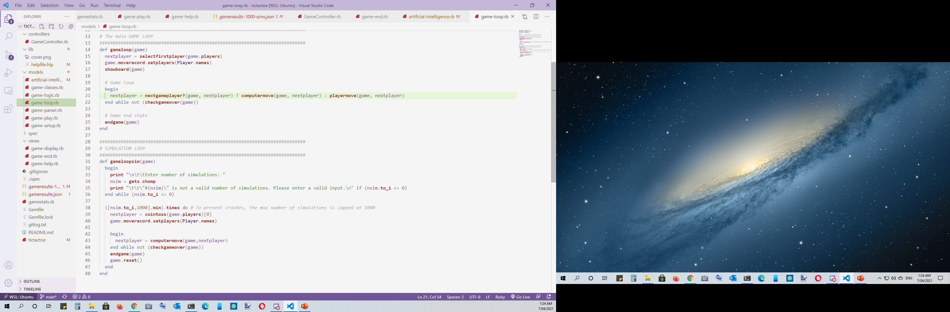

Slide 23
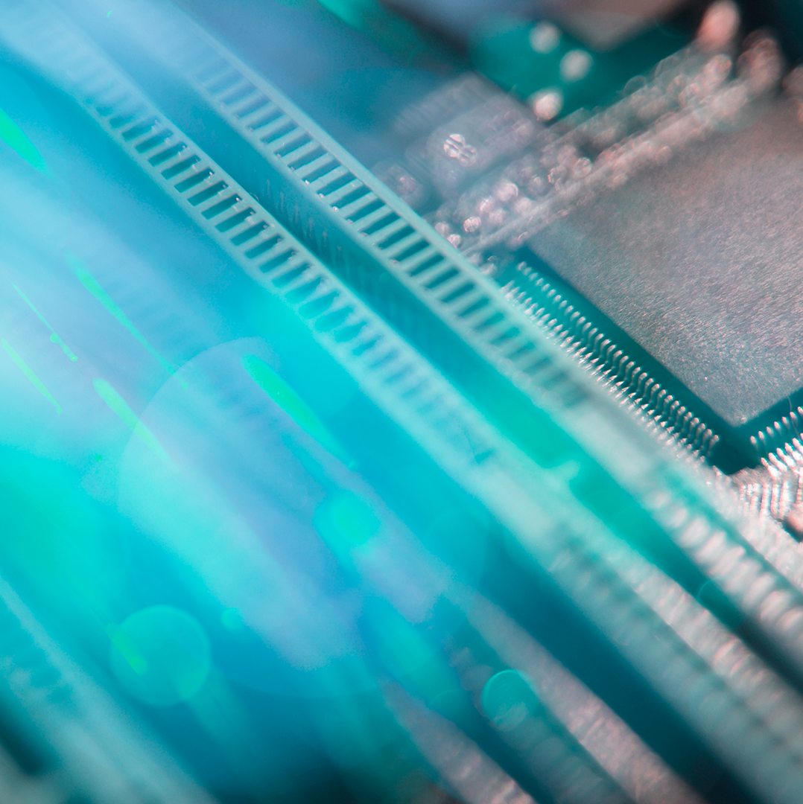
Design Decisions

Slide 24


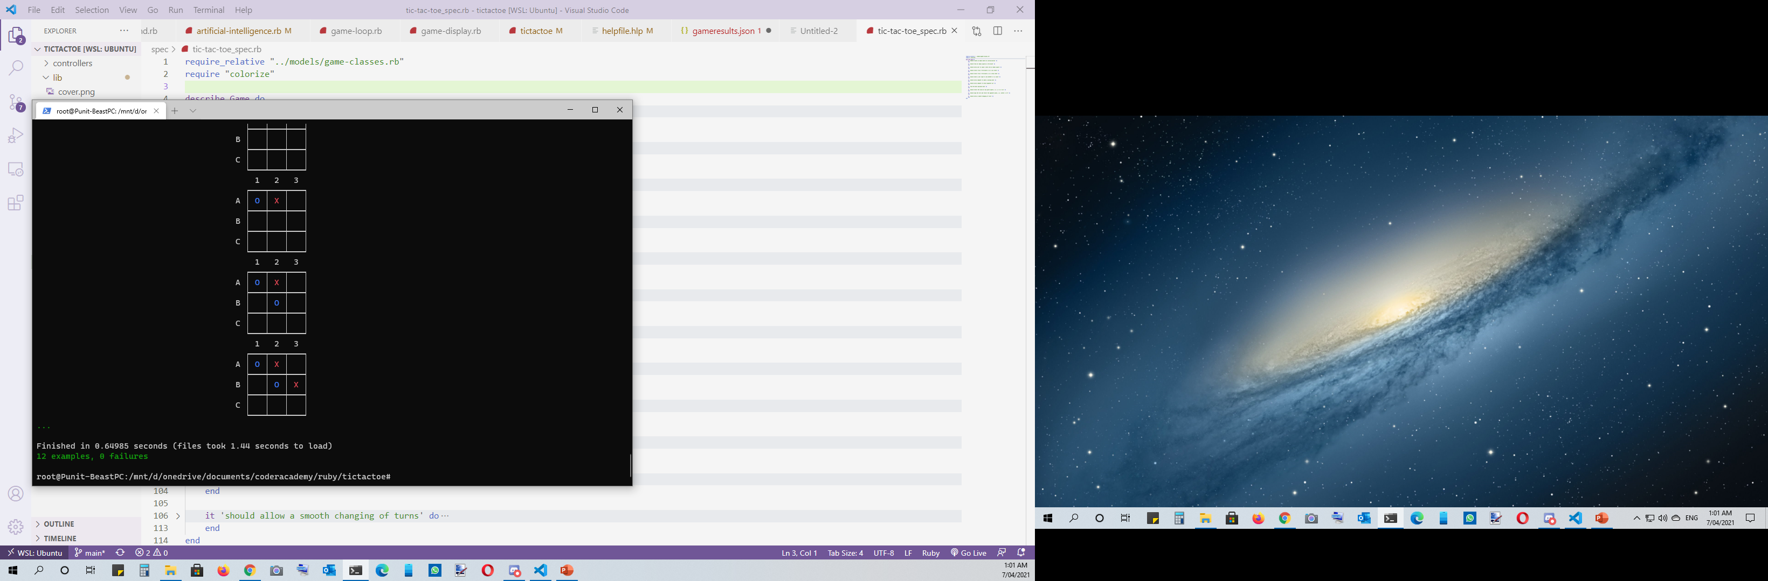
Testing (TDD)

Slide 25
~/home/$ gem install colorize

Slide 26
TT-Why-Prompt? > Selected Not-Selected

Slide 27
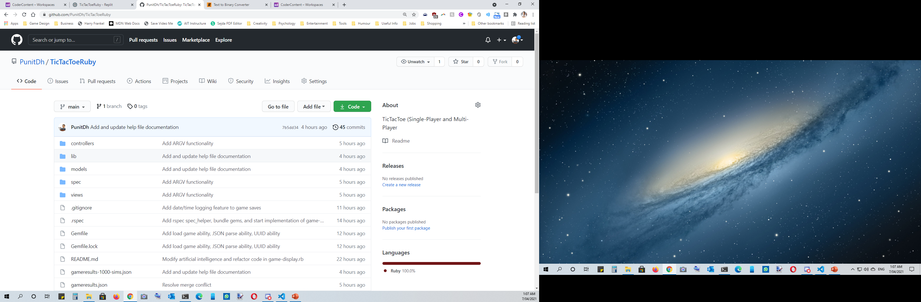
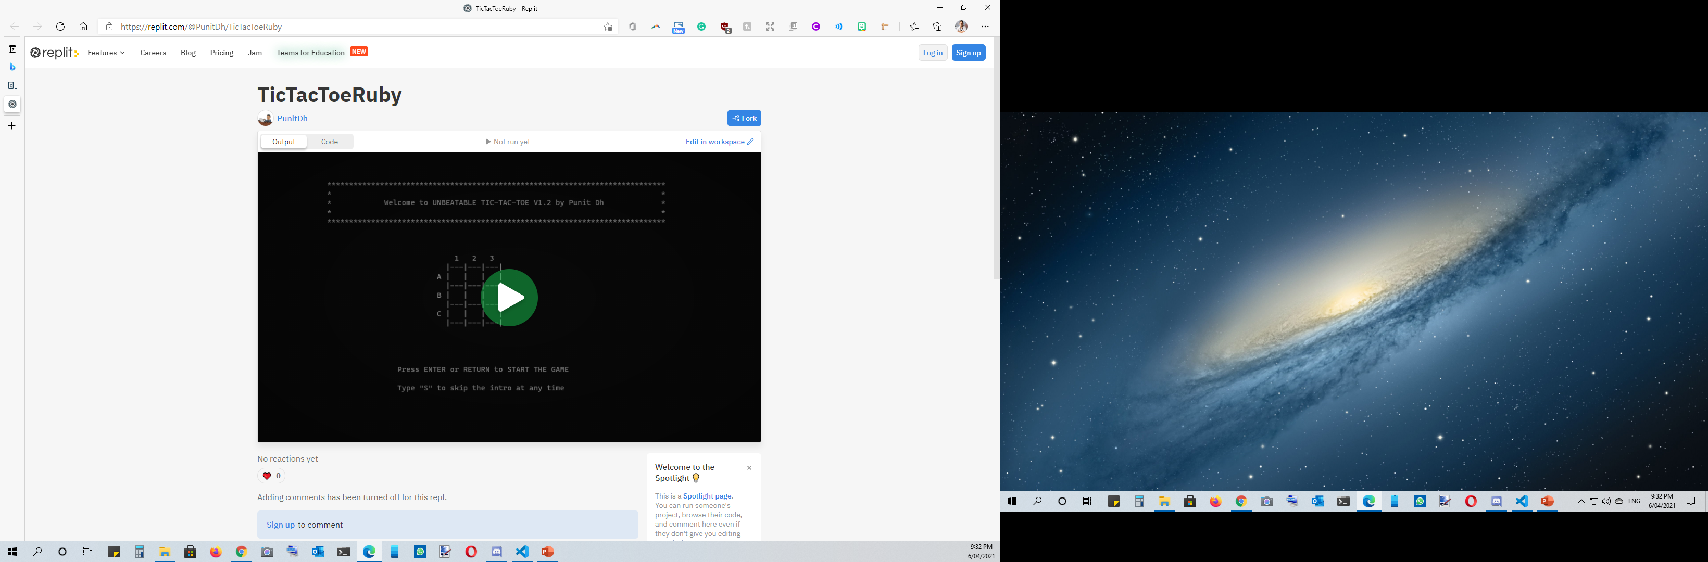
Repository
https://github.com/PunitDh/TicTacToeRuby
https://replit.com/@PunitDh/TicTacToeRuby

Slide 28
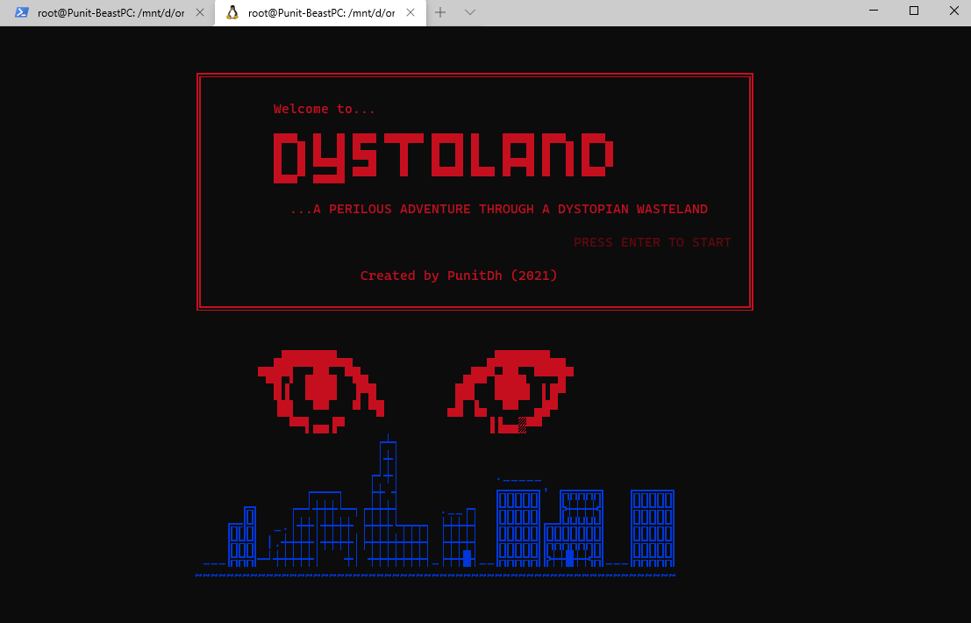
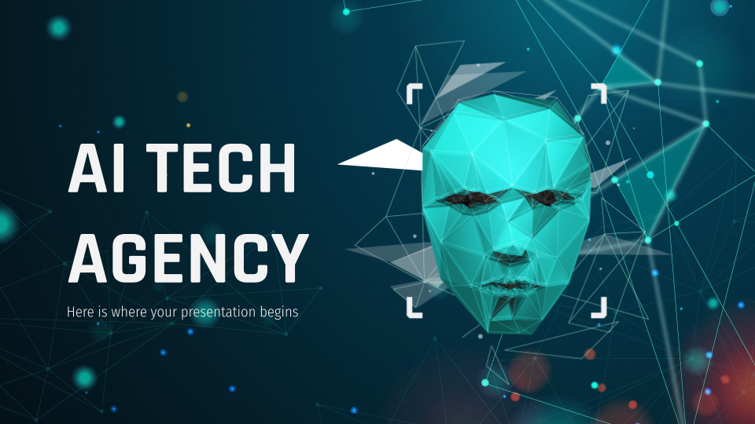
Future Projects…

Slide 29
THANKS!
Do you have any questions?
punit04@gmail.com
https://punitdh.github.io
Please keep this slide for attribution.

